Slide 1
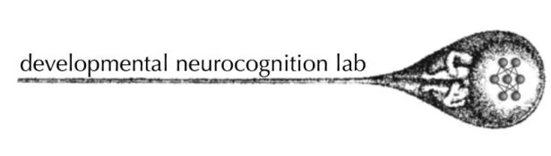

A Connectionist model of
English inflectional morphology
_{Themis Karaminis, 09-May-2008}

Slide 2
Overview
Connectionist models of morphology
  Rumelhart & McClelland (1986)
  Plunkett & Marchman (1991,1993)
  Joanisse & Seidenberg (1999)
  Hoeffner & McClelland (1993)
  Plunkett & Juola (1999)
Multiple Inflections Generator (MIG)
  Aims
  Architecture
  Training set
  Pilot results
Summary/Conclusions

Slide 3
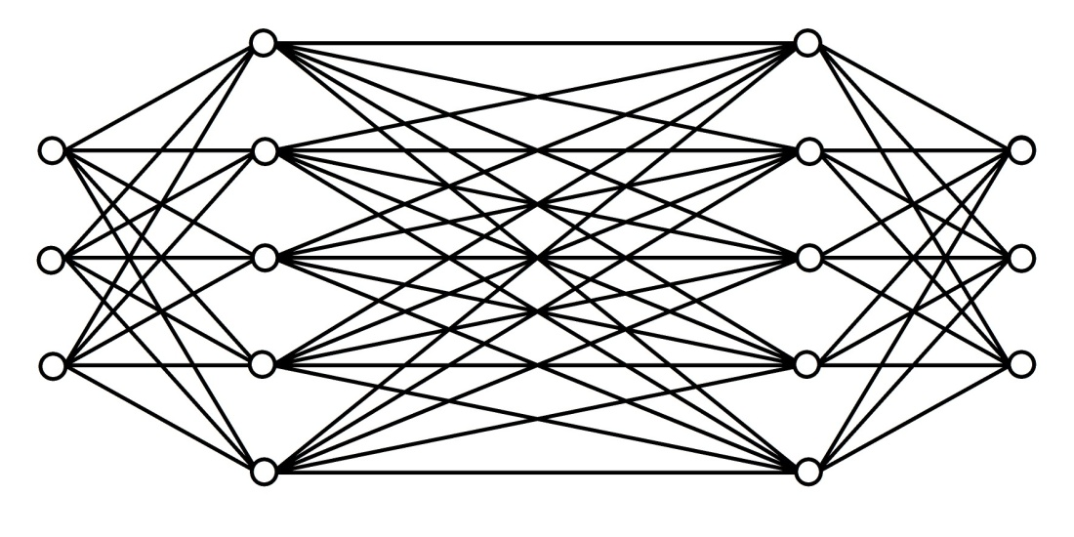
Rumerhalt & McClelland (1986)
Past Tense Acquisition
Phonology → Phonology
Implications
  A connectionist architecture can learn both regular and irregular inflection
  U-shaped learning curve for irregulars
Wickelfeature representations
Phonological representations of root form
Phonological representations of past tense
Encoding network
Decoding/ Binding network
Pattern Associator

Slide 4
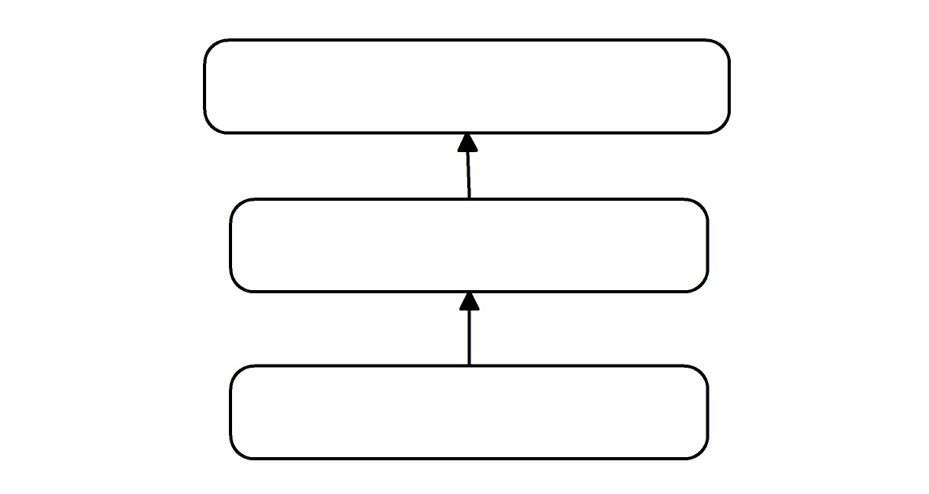
Plunkett & Marchman (1991,1993)
Past Tense Acquisition
Phonology → Phonology
Implications
  Type and token frequency effects
  Incremental training
2-bit encoding for suffixes:
  /t/
  /d/
  /^d/
  no suffix
Distributed phonological representations for the verb stems
(18 bits)
Phonology Output
Hidden Layer
Phonology Input
Cons. - Vow. - Cons.
Vow. - Cons. - Cons.
Cons. - Cons. - Vow.

Slide 5
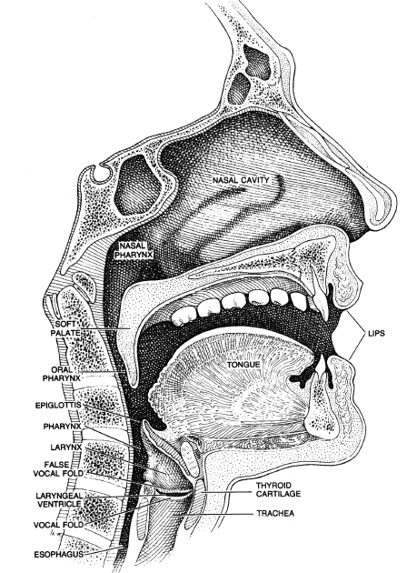
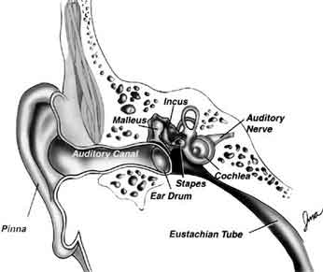
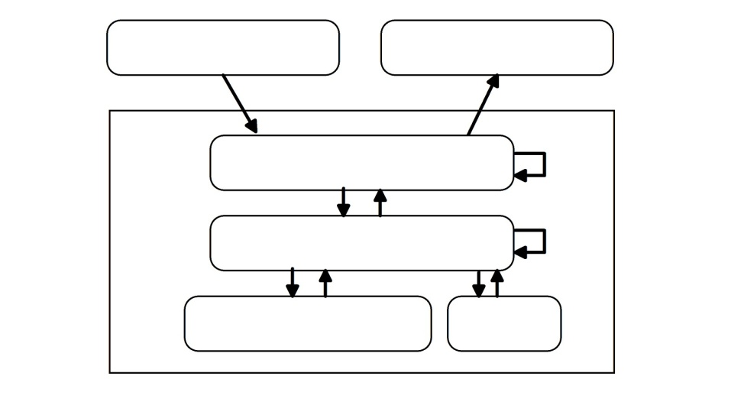
Hoeffner & McClelland (1993)
Verb Inflections: Base, Past tense, Past Participle,3rd sing, Progressive
Phonology, Semantics → Phonology
SLI and the Perceptual Deficit Hypothesis
Implications:
  Different inflections were affected differentially
  Regular inflections were affected more severely
  No-mark errors
Perceptual System
Articulatory System
C
C
C
V
C
C
C
Syl.
Suf.
Phonology
SLI = weaker phonological representations
Semantics
Hidden Units
Core Semantics
Inflection
Word-final stops and fricatives

Slide 6
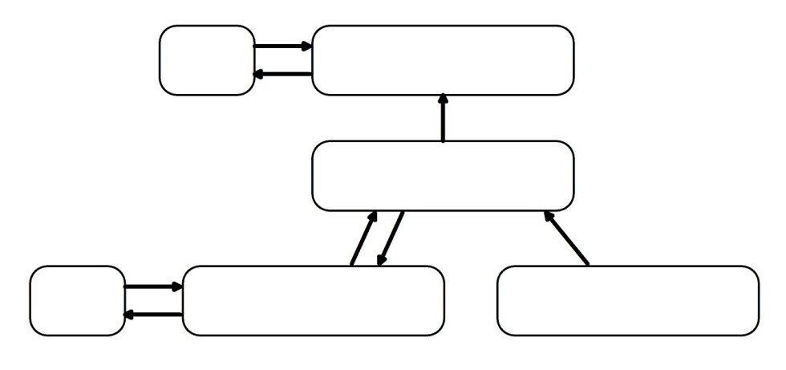
Joanisse & Seidenberg (1999)
Past Tense after brain injury
Phonology Input, Semantics, Phonology Output
Implications
  “Double dissociation” for irregulars and past tenses of nonce words
  Phonological lesions ~ Parkinson’s disease/ Anterior lesion
  Semantic lesions ~Alzheimer’s disease/ Posterior aphasia
C
C
C
V
V
C
C
C
V
C
Localist Semantics (600 units)
+ 1 Past Tense unit
Cleanup
Units
Distributed Phonology
(162 units)
Phonology Output
Severed connections
Phonological lesion =
Hidden Layer
Cleanup
Units
Semantics
Phonology Input
Semantic lesion =
Severed connections
+ Gaussian noise

Slide 7
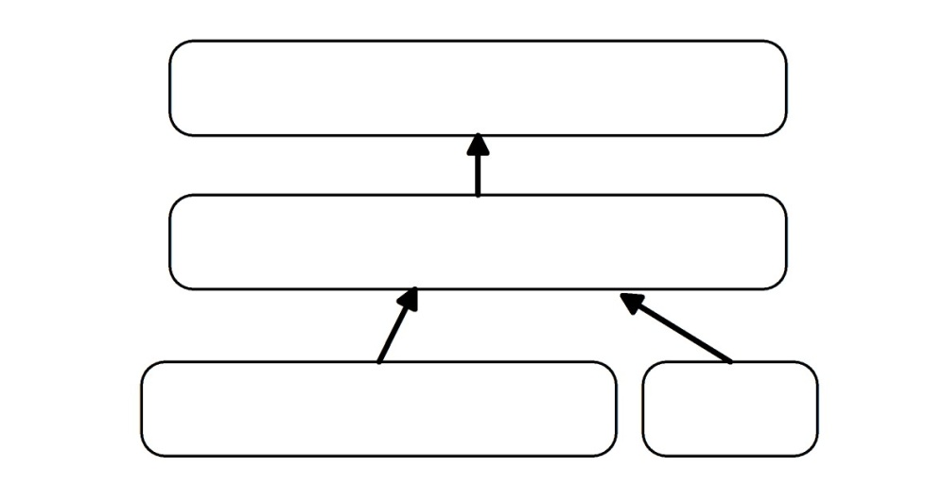
Plunkett & Juola (1999)
Acquisition of verb Past tense and noun Plural
Phonology → Phonology
Implications:
  Regular plural > regular past tense
  Overregularisation nouns > overregularisation verbs
Two extra phonemes for suffixes:
  /t/
  /d/
  /^d/
  /s/
  /z/
  /^z/
Phonology Output
C
C
C
V
V
C
C
C
Hidden Layer
Phonology Input
Target
Inflection
2-bits

Slide 8
Multiple Inflections Generator: Aims
A general system for inflection
  Verbs (Unmarked forms, Progressive, 3rd singular, Past tense)
  Nouns (Unmarked forms, Plural, Genitive)
  Adjectives (Unmarked forms, Comparative, Superlative)
Capture differences in the emergence of different inflections in typical development
Capture error patterns for typical development
Explain SLI, capture error patterns
Capture Optional Infinitive (OI)/ Extended-OI account

Slide 9
MIG: Architecture
Phonology, Semantics → Phonology
PHONOLOGY OUTPUT
HIDDEN LAYER
SEMANTICS
PHONOLOGY INPUT
GRAMMATICAL CATEGORY
TARGET INFLECTION

Slide 10
MIG: Training set
A protolanguage parallel to English
  Data from the Tagged Brown Corpus:
    Frequency of NOUN, VERB and ADJECTIVE categories
    Frequency of different inflection types
    Frequency of regular/irregular types, allophones for regular types (e.g. Past Tense: /t/,/d/,/^d/) and irregular mappings (e.g. Past Tense: Vowel Change, Arbitrary, Identity)
    Phonological overlap between NOUN, VERB and ADJECTIVE categories
  triphonemic strings: CVC, CVV, VCC, CCV
  Non-incremental training regime

Slide 11
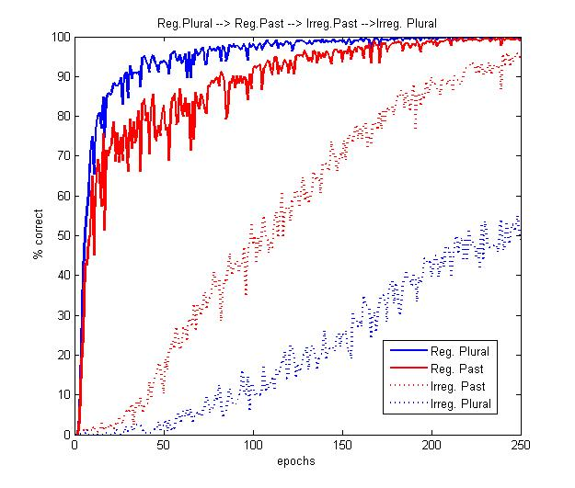
MIG: Results: Normal model (1)
frequency and regularity determine the order of the emergence of different inflections
Reg. Plural → Reg. Past → Irreg. Past → Irreg. Plural

Slide 12
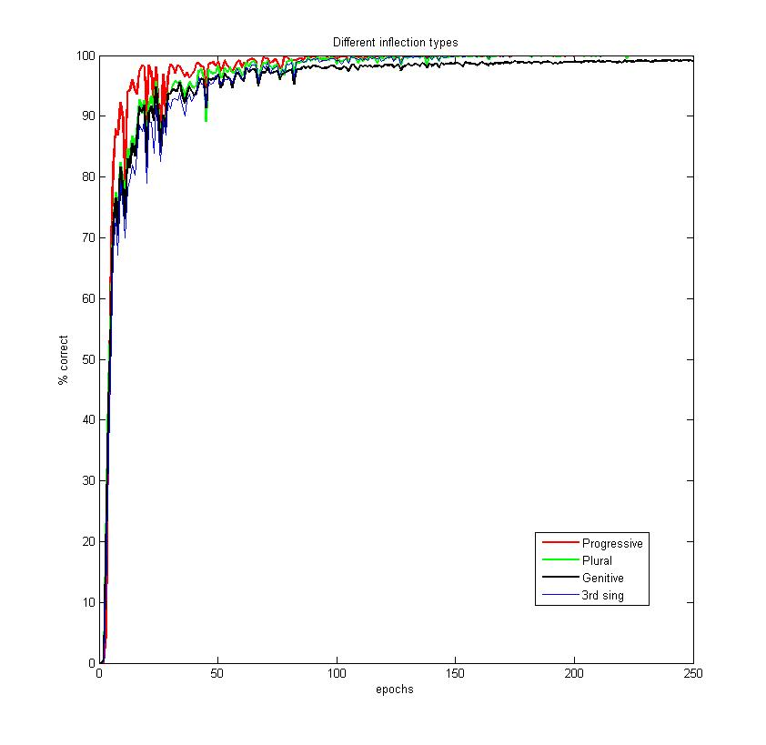
MIG: Results: Normal model (2)
Order of acquisition of different inflections
Berko (1958):Progressive→Plural→Genitive→3rd sing.

Slide 13
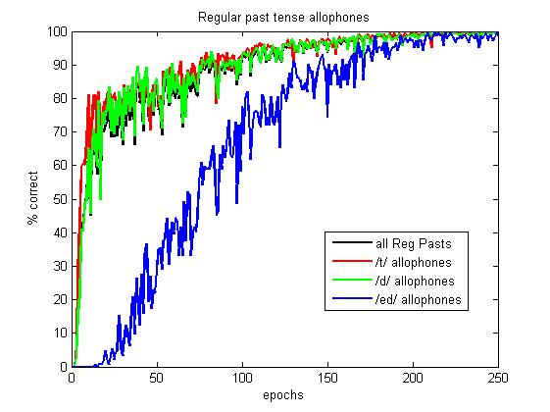
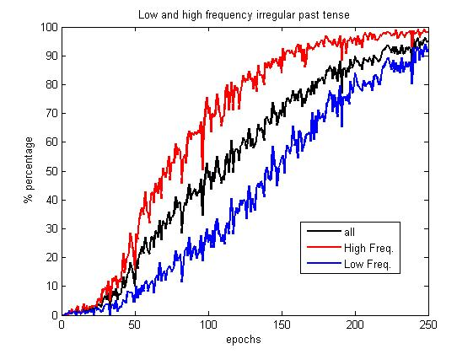
MIG: Results: Normal model (3)
Accuracy in regular past tense allophones determined by frequency
Frequency X Regularity

Slide 14
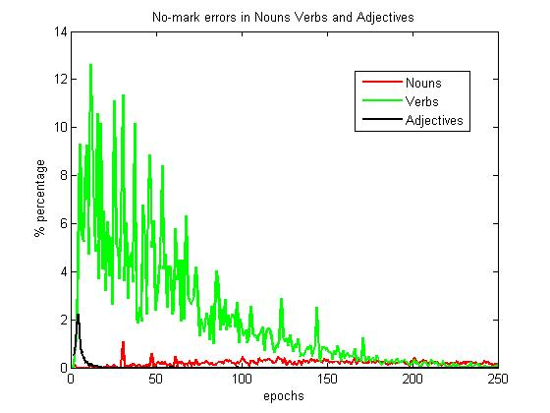
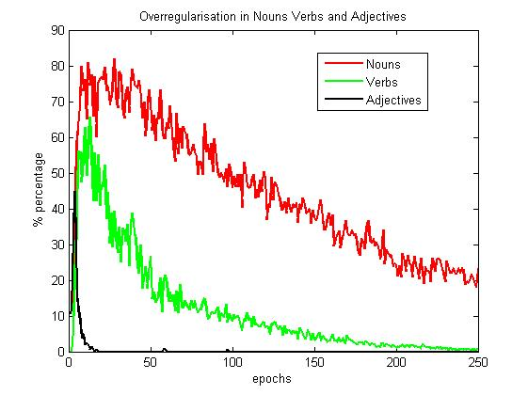
MIG: Results: Normal model (4)
Captures error patterns:
  No-change
  Blend
  Overregularisations
Overregularisation NOUNS >overregularisation VERBS>overregularisation ADJECTIVES
No mark errors for VERBS, but not for NOUNS and ADJECTIVES

Slide 15
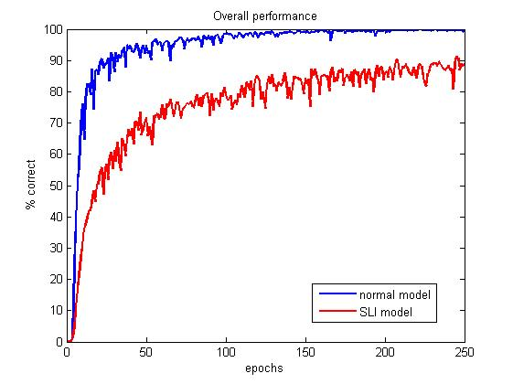
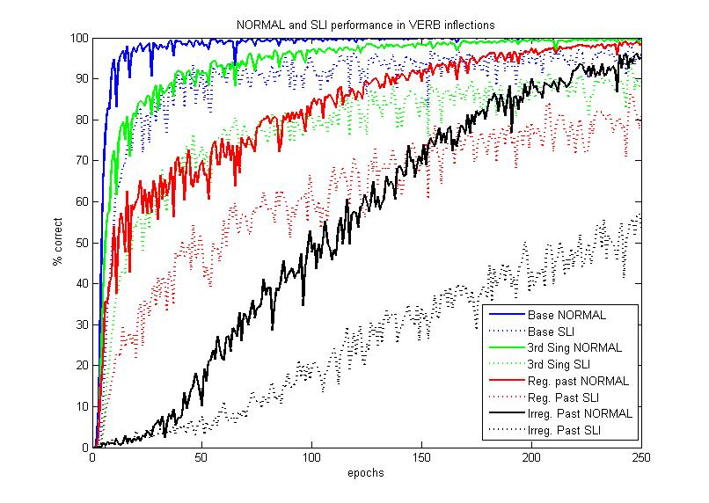
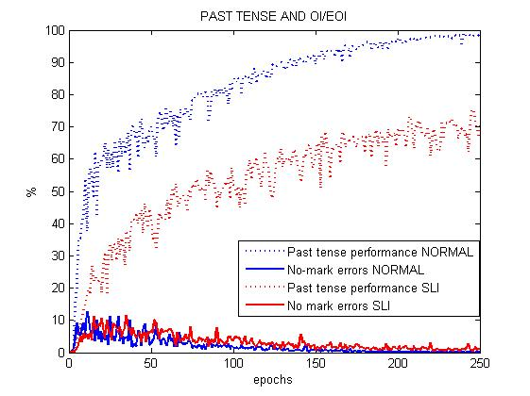
MIG: Results: Impaired model
SLI: ~1/2 hidden units (processing limitations)
Learns more slowly and less accurately
Different inflections are affected differentially
Mimics the EOI

Slide 16
Summary/ Conclusions
A three-layer feedforward connectionist model for different inflections
Incorporates elements of a single route and a dual route architecture
Captures the emergence of inflections based on frequency and regularity
Captures basic error patterns
Simulates EOI for SLI
Future directions:
Extend MIG for Greek (highly inflective)

Slide 17
Thank you!

